Slide 1
Experiments on Daily Aggregate Data

Slide 2
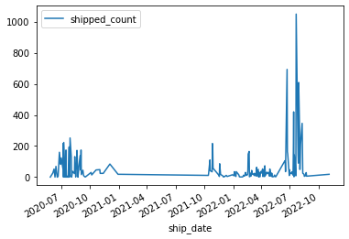
Product name = DT1260SR

Slide 3
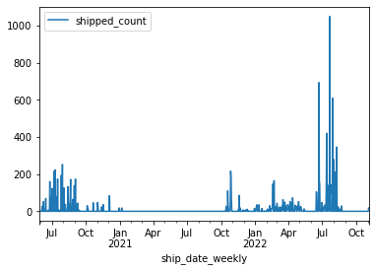
Imputed Data

Slide 4
Experiments on Imputed Data
Normalisation | Error | Forecast sum 2022 | Forecast sum 2023 | Train error | Test error | Window size | Lr
yes | mse | 1637 | 36 | 2.25E-04 | 0.0162 | 15 | 0.001
yes | mse | 167 | 23 | 9.66E-04 | 8.43E-05 | 100 | 0.001
yes | mse | 352 | 27 | 9.76E-04 | error | 350 | 0.001
yes | mse | 1073.195068 | 27 | 3.52E-04 | error | 500 | 0.001
yes | mse | 436.493561 | 26 | 0.0013 | 0.0154 | 6 | 0.001
no | mape | 0 | 0 | 138118 | 7177 | 3 | 0.001
 |  | Actual =6919

Slide 5
Experiments on unImputed Data
Normalisation | Error | Forecast sum 2022 | Forecast sum 2023 | Train Error | Test Error | Window size | Epochs | Lr
NO | mae | 6750 | 12350 | 3.4 | 6.1 | 26 | 445 | 0.001
no | mse | 12300 | 4077 | 9 | 1210 | 26 | 445 | 0.001
no | mse | 6450 | 8780 | 274 | 260 | 26 | 500 | 0.0005
no | rmse | 7600 | 9500 | 5 | 3 | 26 | 445 | 0.001
no | mse | 11900 | 5000 | 86 | 190 | 26 | 90 | 0.001
no | mape | -3 | -6 | 5597394.5 | 100 | 26 | 90 | 0.001
no | mape | 0 | 0 | 113979699494912 | nan | 26 | 650 | 0.001
no | mse | 10500 | 3080 | 269 | 1861 | 26 | 85 | 0.001
no | mse | 7300 | 962000 | 42 | 30 | 26 | 500 | 0.0001
no | mse | 9550 | 4000000000 | 84 | 77809.53906 | 15 | 424 | 0.0001
 |  | Actual=6919

Slide 6
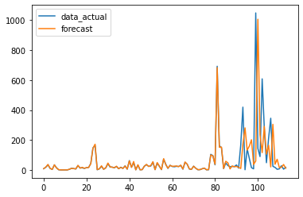
Best Result
2022 Actual vs forecasted
Error | MAE
Forecast sum 2022 | 6750
Forecast sum 2023 | 12350
Train Error | 3.4
Test Error | 6.1
Window size | 26
Epochs | 445
Lr | 0.001

Slide 7
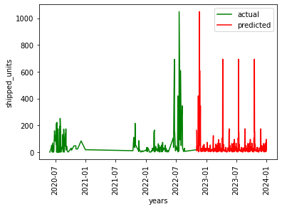
2023 Forecast

Slide 8
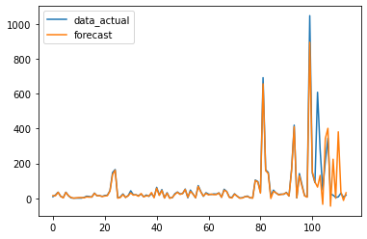
2022 Actual vs forecasted
Error | MSE
Forecast sum 2022 | 6450
Forecast sum 2023 | 8780
Train Error | 1274
Test Error | 260
Window size | 11
Epochs | 500
Lr | 0.0005

Slide 9
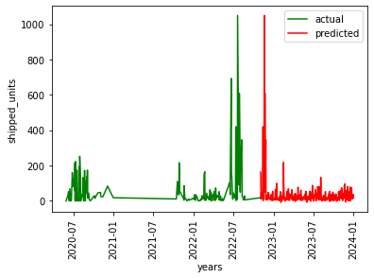
2023 Forecast

Slide 10
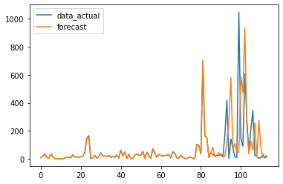
2022 Actual vs forecasted
Error | RMSE
Forecast sum 2022 | 7600
Forecast sum 2023 | 9500
Train Error | 5
Test Error | 3
Window size | 26
Epochs | 445
Lr | 0.001

Slide 11
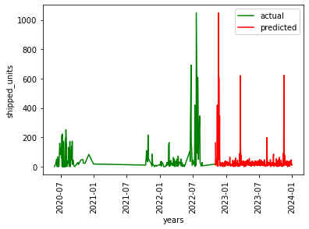
2023 Forecast

Slide 12
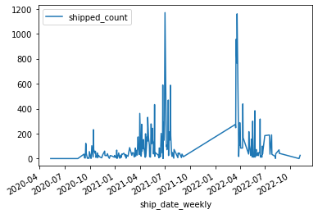
Product name = DT1775

Slide 13
Experiments on Imputed Data
Normalisation | Error | Forecast sum 2022 | Forecast sum 2023 | Train Error | Test Error | Window size | Epochs | Lr
no | mae | 9680 | 43700 | 15 | 101 | 15 | 500 | 0.001
no | mae | 9050 | 35600 | 8 | 90 | 20 | 500 | 0.001
no | mae | 8818 | 12900 | 9.11 | 61 | 25 | 500 | 0.001
no | rmse | 9324 | 16600 | 11 | 53 | 30 | 445 | 0.001
 |  | Actual=8220

Slide 14
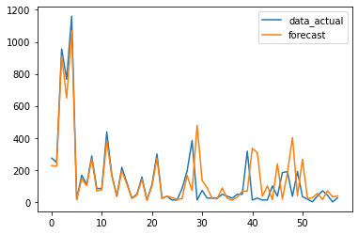
2022 Actual vs forecasted
Error | MAE
Forecast sum 2022 | 8818
Forecast sum 2023 | 12900
Train Error | 9
Test Error | 61
Window size | 25
Epochs | 500
Lr | 0.001

Slide 15
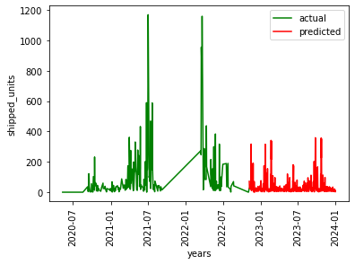
2023 Forecast

Slide 16
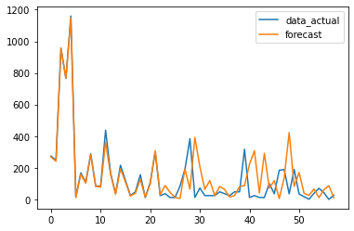
Error | RMSE
Forecast sum 2022 | 9300
Forecast sum 2023 | 16600
Train Error | 11
Test Error | 53
Window size | 25
Epochs | 500
Lr | 0.001

Slide 17

2023 Forecast

